Slide 1
Biol 7200: Programming for Bioinformatics Week 10 assignment demos and broken code

Slide 2
Plan for today
Code demos
Broken code
If there’s time, review material

Slide 3
Broken code structure reminder
What’s it trying to do?
What’s wrong with it?
How would you fix it?

Slide 4

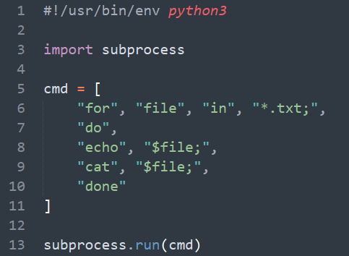
Broken code 1
What’s it trying to do?
What’s wrong with it?
How would you fix it?

Slide 5
Broken code 1
What’s it trying to do?
Use a shell loop to print the name and contents of some files
What’s wrong with it?
for is not an executable so Python doesn’t know how to run the command
How would you fix it?
Use shell=True in the subprocess

Slide 6
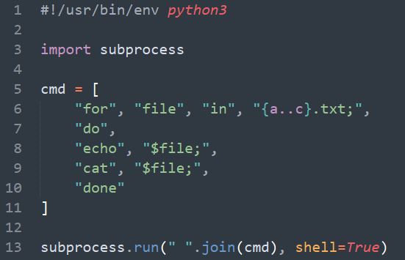
Broken code 2
What’s it trying to do?
What’s wrong with it?
How would you fix it?

Slide 7
Broken code 2
What’s it trying to do?
Use a shell loop to print the name and contents of some files
What’s wrong with it?
Brace expansion - {a..c} is not supported by all shells
subprocess.run() calls /bin/sh not /bin/bash which can’t handle brace expansion
How would you fix it?
Use executable=‘/bin/bash’ in the subprocess command

Slide 8
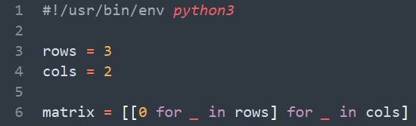
Broken code 3
What’s it trying to do?
What’s wrong with it?
How would you fix it?

Slide 9
Broken code 3
What’s it trying to do?
Create a 3 by 2 matrix of 0s
What’s wrong with it?
int is not iterable
How would you fix it?
Use range(int) instead

Slide 10
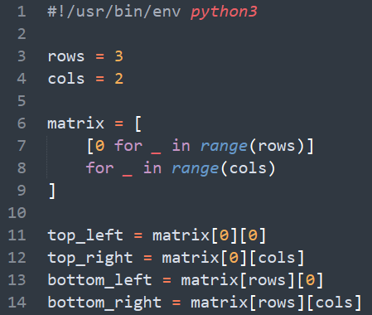
Broken code 4
What’s it trying to do?
What’s wrong with it?
How would you fix it?

Slide 11
Broken code 4
What’s it trying to do?
Build a matrix and extract the corner values
What’s wrong with it?
The innermost-list would have 3 elements
The outermost-list would have 2 elements
i.e., it makes a list of length rows for each of range(cols)
How would you fix it?
Switch the rows and cols in the list comprehension
N.B., for nested list comprehension, the outermost for loop is the last one read. For a traditional loop, the outermost loop is the first one read.

Slide 12
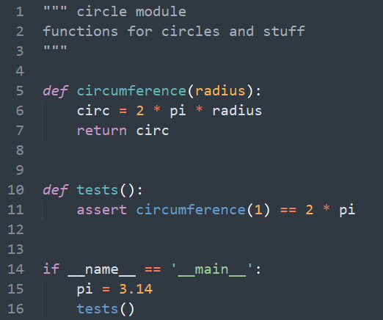
Broken code 5
What’s it trying to do?
What’s wrong with it?
How would you fix it?

Slide 13
Broken code 5
What’s it trying to do?
Define a module with circle-related functions
Write tests which are run when the module is executed directly
What’s wrong with it?
pi is defined in the if name == main block
pi is only created when the module is executed as a script
How would you fix it?
Define pi as a module-level constant

Slide 14
End of Lesson

